Slide 1

LSAMP Project Presentation
Yizhak Cohen, Kaitlin Pulmano

Slide 2
Goals of Internship Project:
Data Collection and Cleaning
Compiled data from various cohort sheets in the LSAMP Roster and Demographics file
Compiled data from various cohort sheets from the ALEKS PDF Reports from 2021 to 2023 and merged them into one dataset
Including important variables such as status, module, cohort year, main math topics, and math subtopics
Data management and analysis
Analyzed key demographic metrics such as gender distribution, GPA, major fields of study change
Evaluated the effectiveness of student placement processes, ensuring alignment with SCBC program goals to enhance student academic success.

Slide 3
Data Collection and Cleaning
Clarify Reporting Needs: Determine the necessary data for LSAMP participants and ALEKS placement results.
Data Collection: Gather data from the LSAMP roster, ALEKS PDFs, and LSAMP demographic records.
Data Cleaning: Standardize naming conventions and handle missing data (e.g., missing emails, missing student IDs, and duplicate records).
Merging Data: Combine LSAMP and SCBC datasets, creating flags for SCBC participation and LSAMP participation and ensuring correct semester alignment.
Evaluate Placement: Assess whether students are correctly placed into LSAMP or SCBC cohorts based on available data and performance.
Notes:
Explain how I gathered ALEKs PDF data and how I processed it

Slide 4
Data Collection and Cleaning (cont.)
Data request to IR and Math Dept
Modify the export to IRSA to include student ID, full name, email, and the earliest ALEKS date for demographic data
These identifiers will help IRSA match and return the missing data for accurate analysis.

Slide 5
Data Exploration and Analysis
Exploratory Data Analysis: Created graphs to analyze LSAMP demographics and ALEKS math placement status.
Comparative Analysis: Compare LSAMP students' performance with their first term at Chico State to their last term at Chico State to assess SCBC impact.
Identify and categorize math topics from the SCBC (2021-2023) into "mastered," "learned," and "ready to learn" statuses to assess proficiency and guide course development in ALEKS math topics.

Slide 6
Data Exploration and Analysis: LSAMP Demographics
"QMD Exploration Demographics of LSAMP Participants"
Demographic variables such as: Gender, Major Departments/Majors, Academic Levels, First Generation Status, and GPA graphs were made to demonstrate distribution among LSAMP participants
Additional graphs were made to demonstrate SCBC's effectiveness on LSAMP participants' GPAs
Comparisons between those who participated in SCBC vs non-participants
GPA trends (First Term vs. Last Term)
GPA trends based on major departments demographics (First Term vs. Last Term)
How GPA was directly impacted by SCBC participation during first term at Chico State

Slide 7
Program’s data issues
Inconsistent Data Naming:
Variability in column names (e.g., student_id vs. student_id_3) complicates data integration and requires additional cleaning steps.
Disorganized Files:
Lack of clear folder structures lead to inefficiencies when accessing and processing datasets.
Duplicate datasets
Data Gaps and Quality:
Missing or inaccurate data, such as LSAMP demographics or placement information, hindered comprehensive analysis and decision-making.

Slide 8
LSAMP Research Questions:
We wanted to compare the LSAMP Participants ALEKS performance to a similar population, so we came with two research questions to help us understand:
Determining what specific math topics, should be put into SCBC?
Does SCBC help student academic success in their first-year math class/academic success overall?

Slide 9
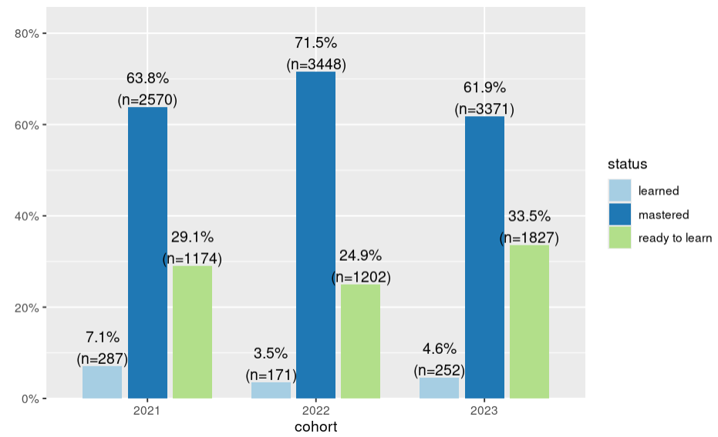
ALEKS topics findings (Pt. 1)
Looking at each status overall, there is no clear increasing or decreasing trend in the % of items mastered over time or ready to learn
For example, in 2021, 63.8% of topics covered in Aleks were mastered. 29.1% were ready to learn, but in 2023, the % of mastered topics decreased to 61.9%

Slide 10
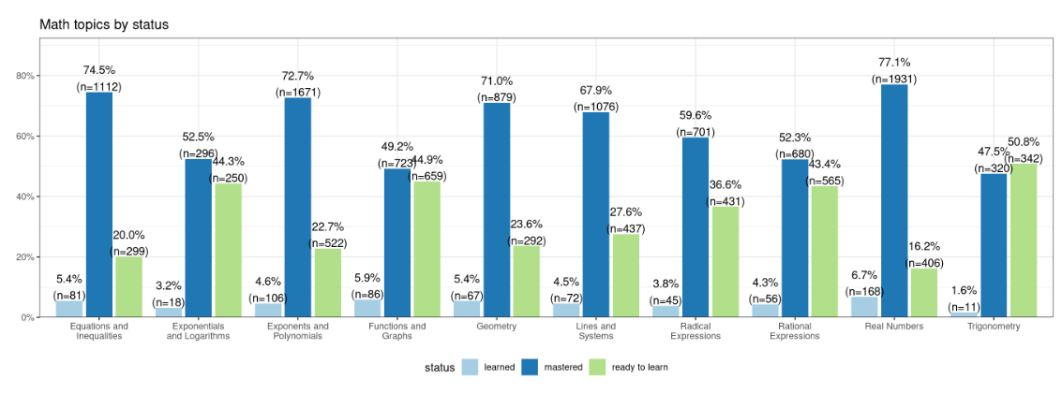
ALEKS subtopics findings (Pt. 2)

Slide 11
ALEKS topics findings (Pt. 2)
The math topics most students have mastered include Real Numbers (77%), Equations and Inequalities (74.5%), Exponents and Polynomials (72.7%), and Geometry (71%)
The lowest mastered topics were Trigonometry (47.1%), Functions and Graphs (49.2%), Rational Expressions (52.3%), and Exponentials and Logarithms (52.5%)
The highest ready to learn topics are Trigonometry (50.8%), Functions and Graphs (44.9%), Exponentials and Logarithms (44.3%), and Rational Expressions (43.4%)

Slide 12
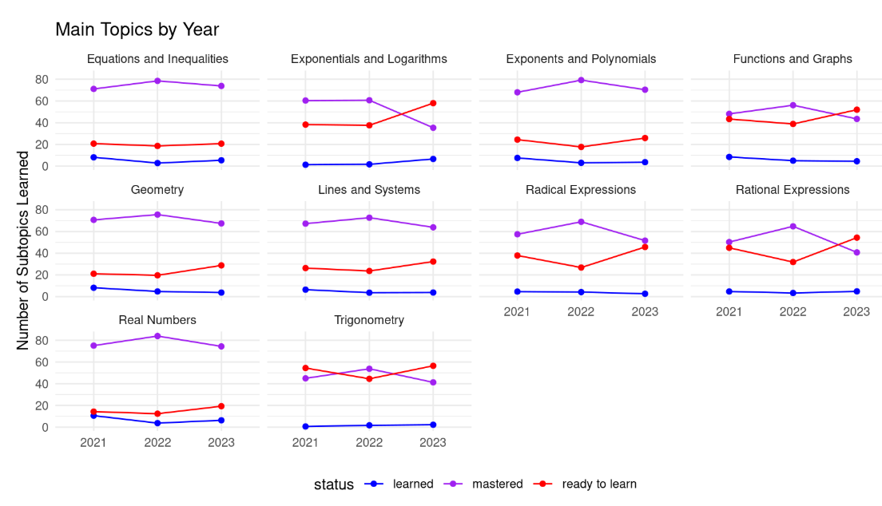
ALEKS topics findings (Pt. 3)
Notes:
There is about 200 count increase in number of mastered In real numbers from 2021 to 2023

Slide 13
ALEKS topics findings (Pt. 3)
There is a decrease in mastery for Exponential and Logarithms from 60% to 40% from 2021 to 2023
Inversely, there is an increase in ready to learn status for Exponential and Logarithms topic from 40% to 60% (2021-2023)
There is an increase in ready to learn for Real Numbers from 20% to 22% from 2021 to 2023
No clear increasing or decreasing trend in the % of items mastered over time for Geometry, Inequalities, Exponents and Polynomials, Functions and Graphs, Lines and Systems, Trigonometry, Radical and Rational Expressions

Slide 14
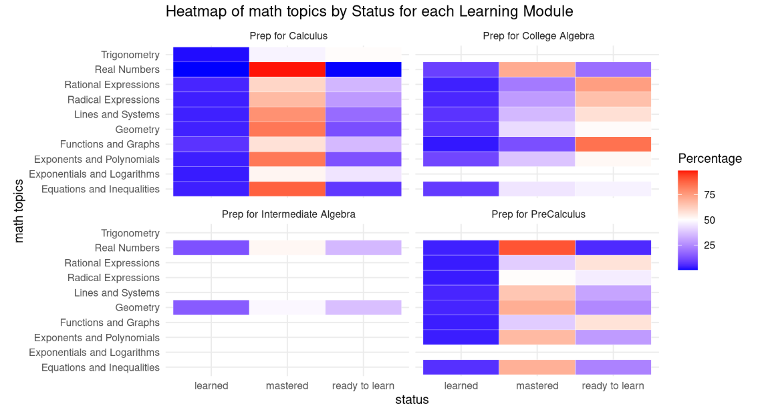
ALEKS topics findings (Pt. 4)
The % is calculated by row for each module. So each row adds up to 100%

Slide 15
ALEKS topics findings (Pt. 4)
Prep for Calculus Module:
Students have mastered Real Numbers by 85-90% with both the Learned and Ready to Learn statuses close to 10% or below
They have mastered topics such as Geometry, Equations and Inequalities, Exponents and Polynomials at around 68% or more
Prep for Pre-Calculus Module:
Students have mastered Real Numbers by 75-80%
The majority of them (55-60%) are Ready to Learn Functions and Graphs and Rational Expressions
Prep for College Algebra Module:
Most topics show a Ready to Learn status with percentages above 50%, except for Real Numbers, which 50-60% of students have mastered it
70% of students are Ready to Learn the Functions and Graphs topic

Slide 16
Recommendations
The Real Numbers topic is well-covered and many students seem to master this topic easily
There should be more emphasis in Functions and Graphs, Exponential and Logarithms, Rational Expressions, and Trigonometry

Slide 17
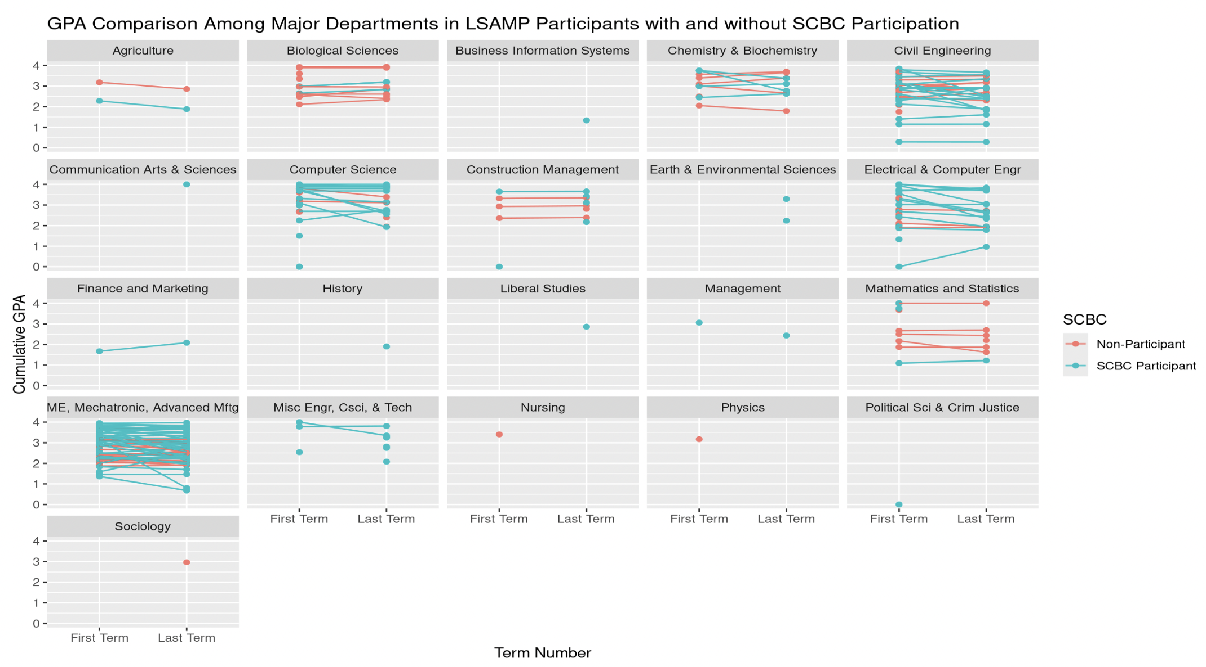
LSAMP/SCBC Demographics Findings
GPA Comparison Among Major Departments in
LSAMP Participants with and without SCBC
Participation:
In many departments (e.g., Chemistry & Biochemistry,
Civil Engineering), SCBC participants generally show stable or
slightly increasing GPAs, while non-participants exhibit
varied trends.
In some departments, such as Biological Sciences and
Civil Engineering, the GPAs of SCBC participants seem to
converge or improve relative to non-participants over time.
Overall, SCBC participants often display more consistent
or improving GPA trends compared to non-participants, though
the patterns vary across departments. Some departments,
such as Sociology and Liberal Studies, have limited data, which
Makes interpretation more challenging.

Slide 18
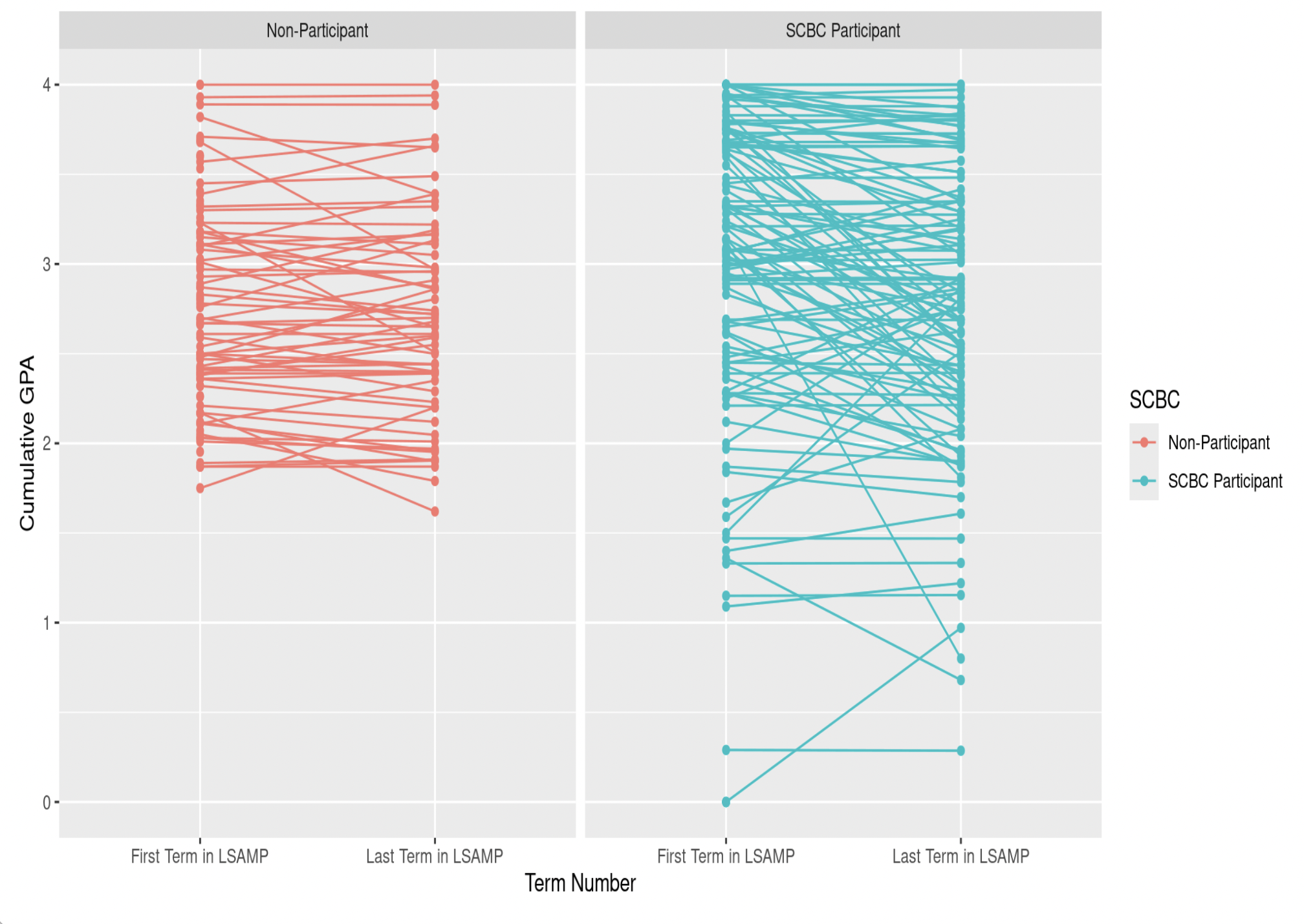
Findings Cont.
GPA Improvement Across Semesters for SCBC Participants:
SCBC Participants (blue) shows more consistent GPA stability or improvement, with many clustering around higher GPA ranges (3.0-4.0)
Non-Participants (red) display more variability, including declines, stability, and occasional improvements
SCBC participants appear to potentially benefit from program engagement, resulting in less drastic downward trends compared to non-participants. However more in depth analysis needs to be conducted in order to determine this.

Slide 19
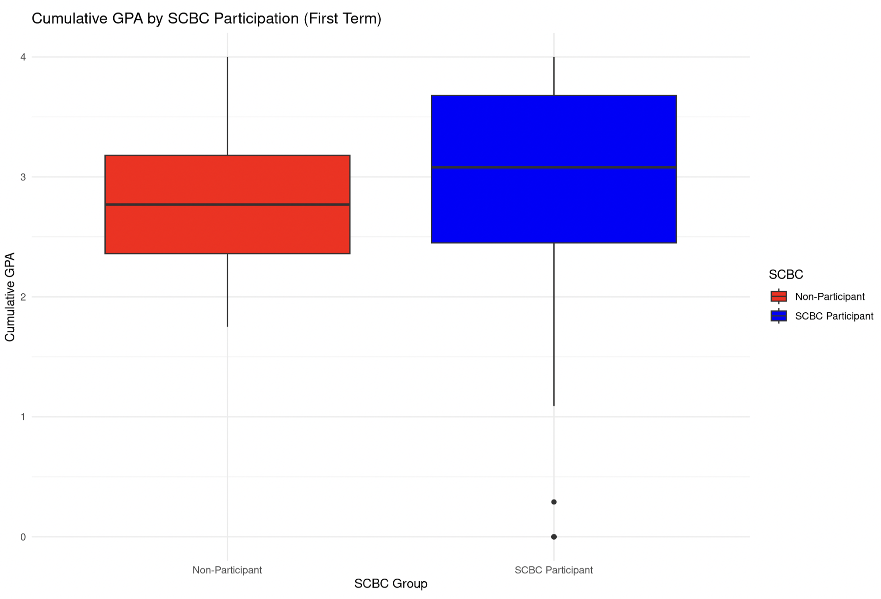
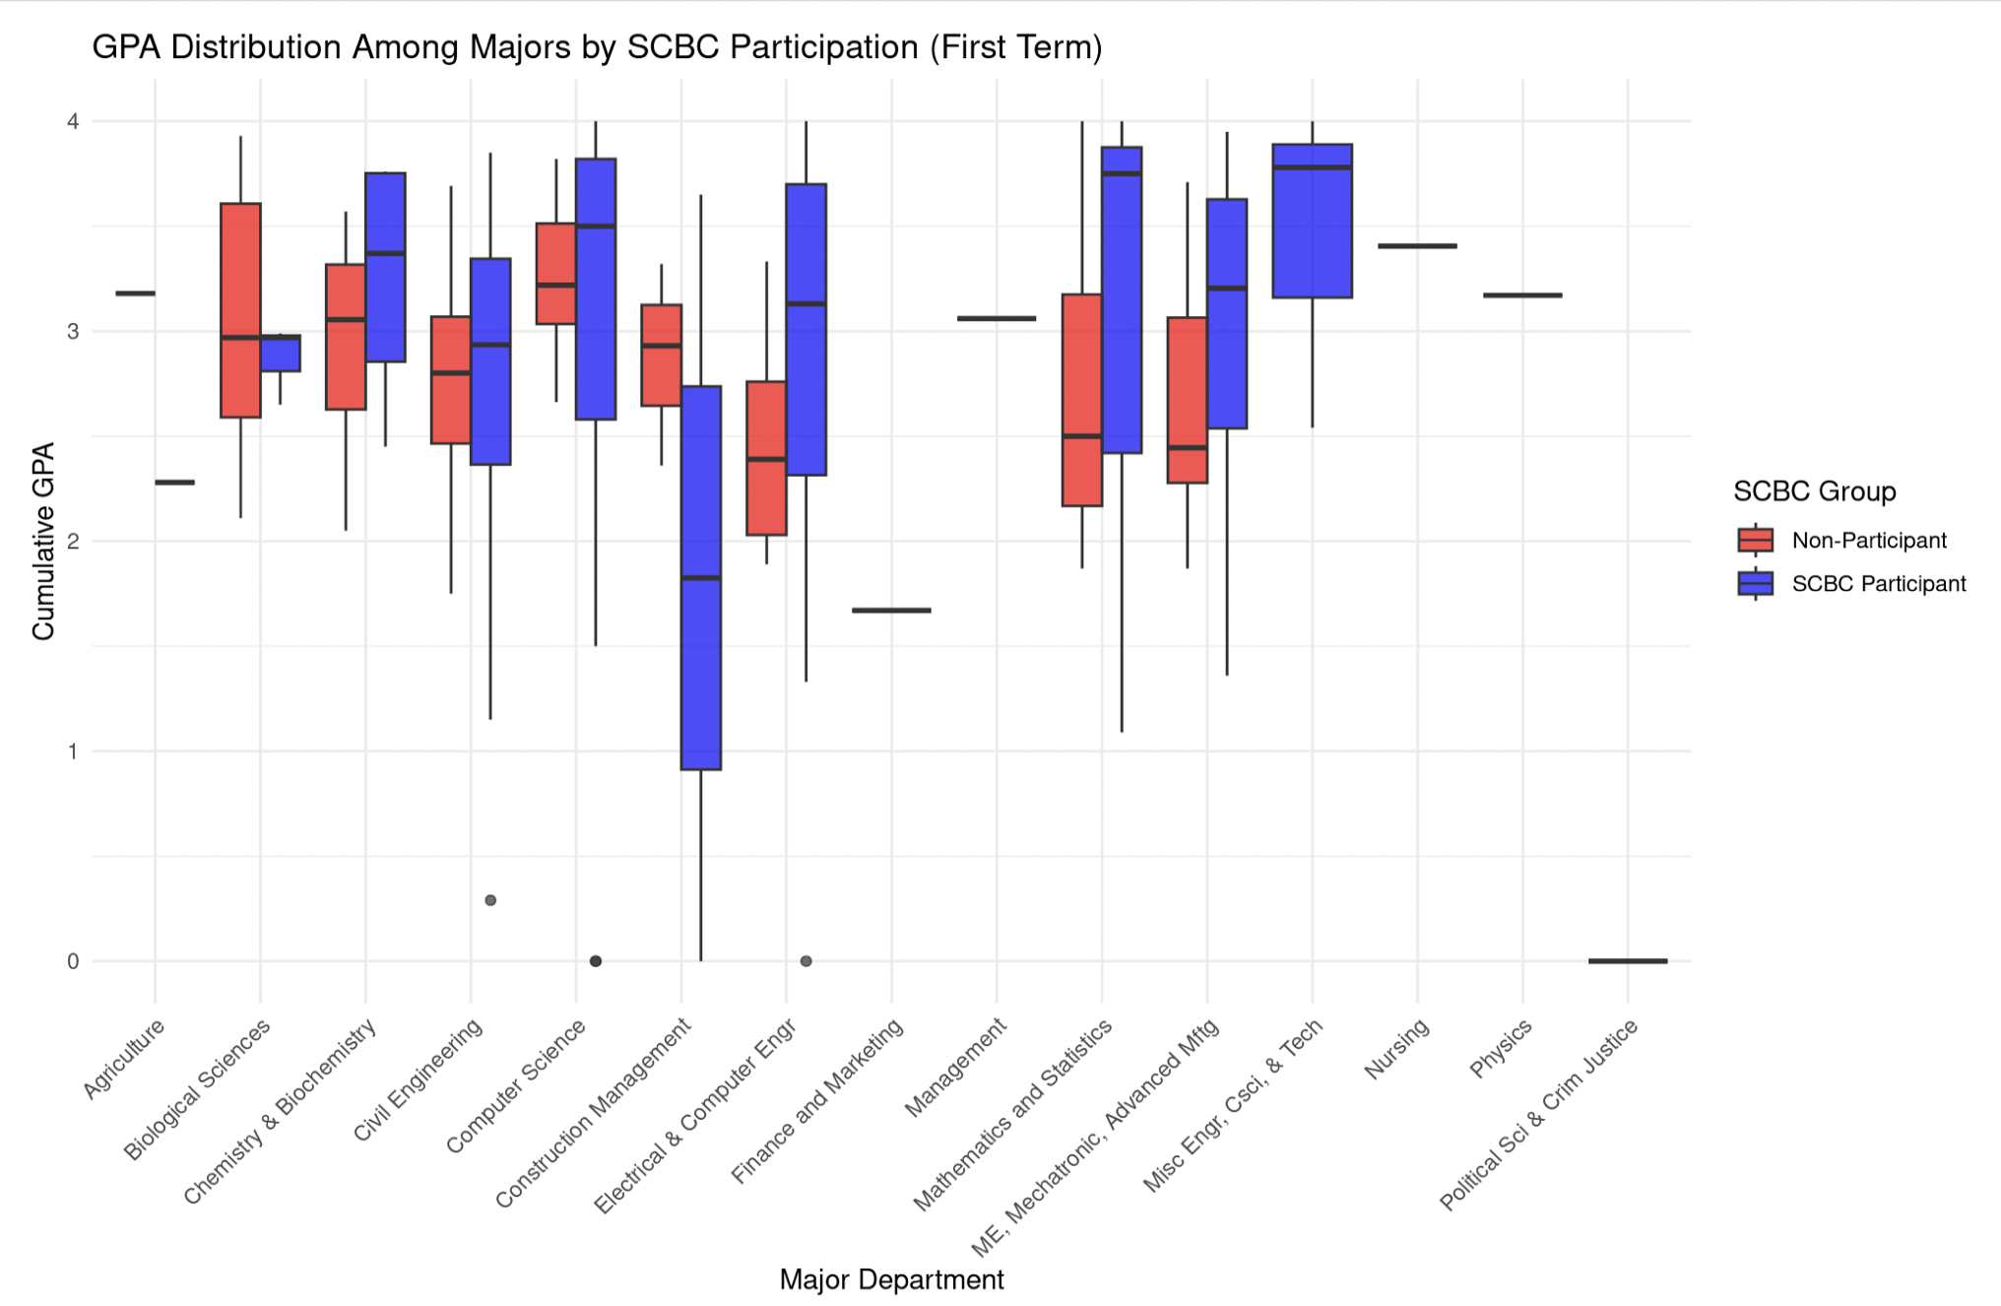
Findings Cont.
GPA Distribution Among Majors: SCBC Participants demonstrate more variability in GPA compared to non-participants specifically in Construction Management, Electrical and Computer Engineering, and Math and Statistics. Overall, all majors in SCBC demonstrate a higher cumulative GPA compared to non-participants indicating the strength of SCBC for LSAMP students' first term in Chico State.
Freshman Year GPA Comparison by SCBC Participation: SCBC participants demonstrate a higher cumulative GPA range (2.5-3.75) compared to non-participants (2.5-3.75).

Slide 20
Conclusion/Ending Statements
Integration of LSAMP and ALEKS data is a crucial step for understanding the impact of SCBC on student performance. We also ensured that the QMD and R script code is reproducible and stored in Box
While data cleaning and merging have been completed, some gaps in student demographics and ALEKS participation remain.
By working with IRSA to fill in these missing details, we can ensure more accurate and comprehensive analysis.
Moving forward, we aim to complete the analysis and present insights on the effectiveness of the SCBC in supporting LSAMP students.

Slide 21
Next Steps
Next Steps: Follow up on update export to IRSA for missing data and demographics, and proceed with analysis once data is received.
Cleaning and combining graduation and class grade on first GE/Math course
Compare ALEKS score to success in the first math class (does our cutoff scores provide a good placement in an appropriate math class)

